Slide 1

A
A
A
A
A
A
A
A
A
A
A
A
1st Machine Learning meetup
Notes:
We incredibly happy to be here today for 2 reasons:
Marcos, Santi and I are going to be able to present a project where we, as volunteers, have been putting a lot of time and effort in the past two months. We’ll be telling you more during the session about why we believe in this and how we are connected.
Ask someone: when was the last time you were in an in-person event with this amount of people organised by an association? APPLAUSE
First:
Thanks to Monta. Thanks to Casper & Anders & Dionysia (This wouldn’t be possible without you). Applause!!. Cool office

Slide 2

Agenda
The Team
Objective
Overall Process.
Some Lessons Learned for future.

Slide 3
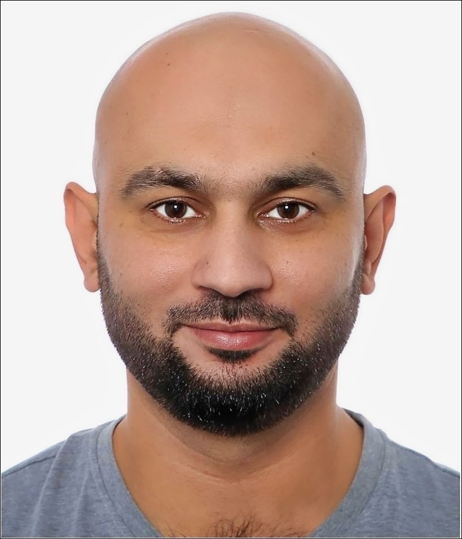
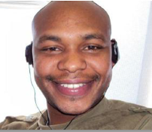
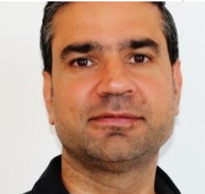
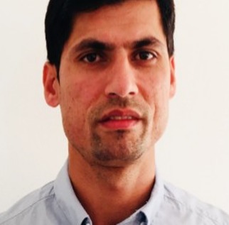
Team
Sana Ullah Khan
Business Analytics MsC student at DTU.
Charles Maina
MSC Business Management.
Lund University.
Yaser Al-Dammad
MSc in IT,
Student at syddansk.
Majid Khan
Comp-science
Blekinge Institute of tech.

Slide 4
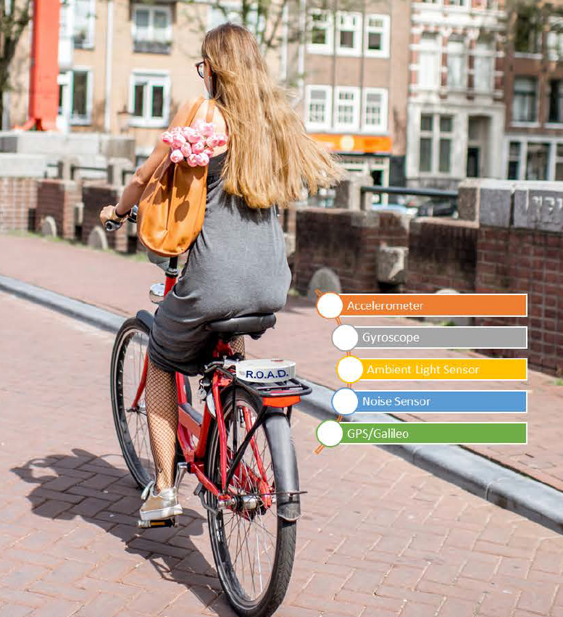
Objective
The goal of this project is to classify the road issues experienced by cycling (potholes, bumps, concrete expansion joints, and storm drain basins) from the 3D accelerometer and gyroscope data.

Slide 5
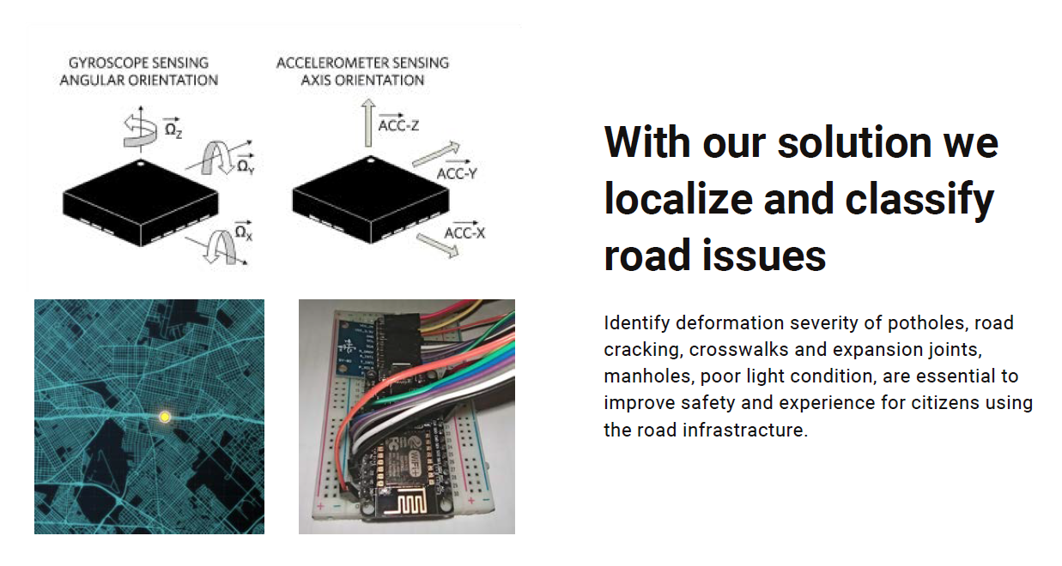
Objective

Slide 6
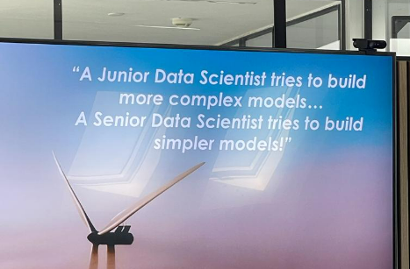
Inspiration:

Slide 7
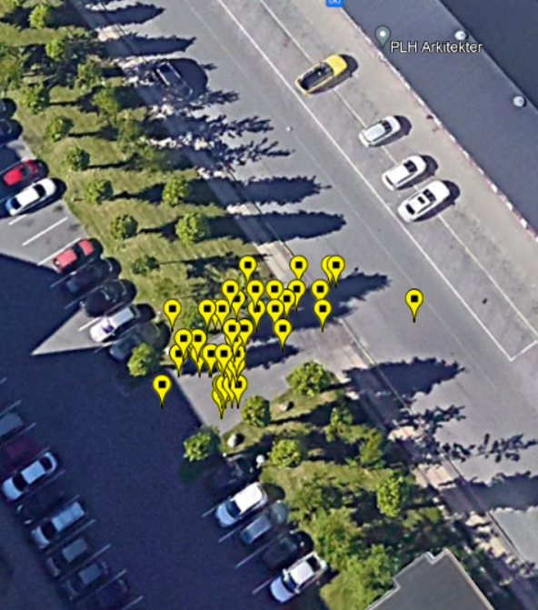
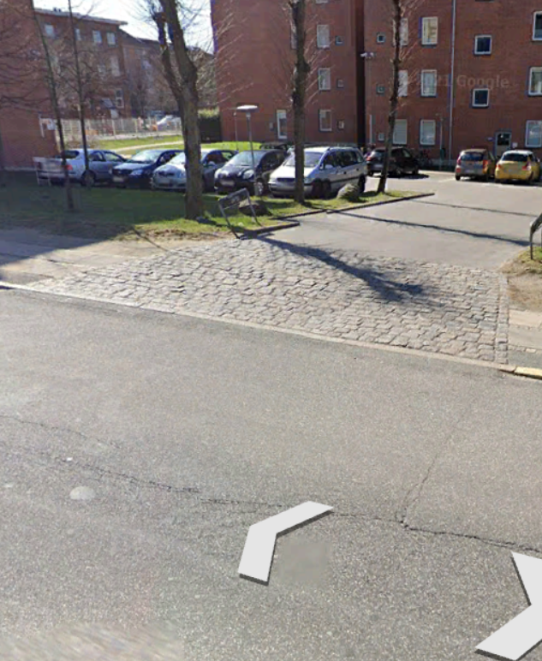
Bricks kml data

Slide 8
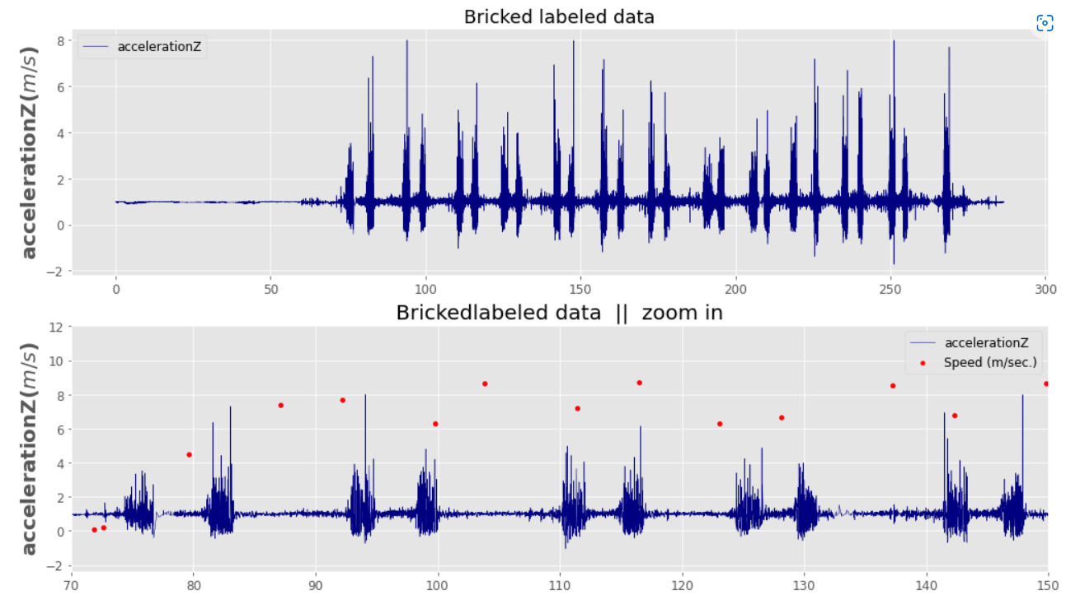
Bricks data plots

Slide 9
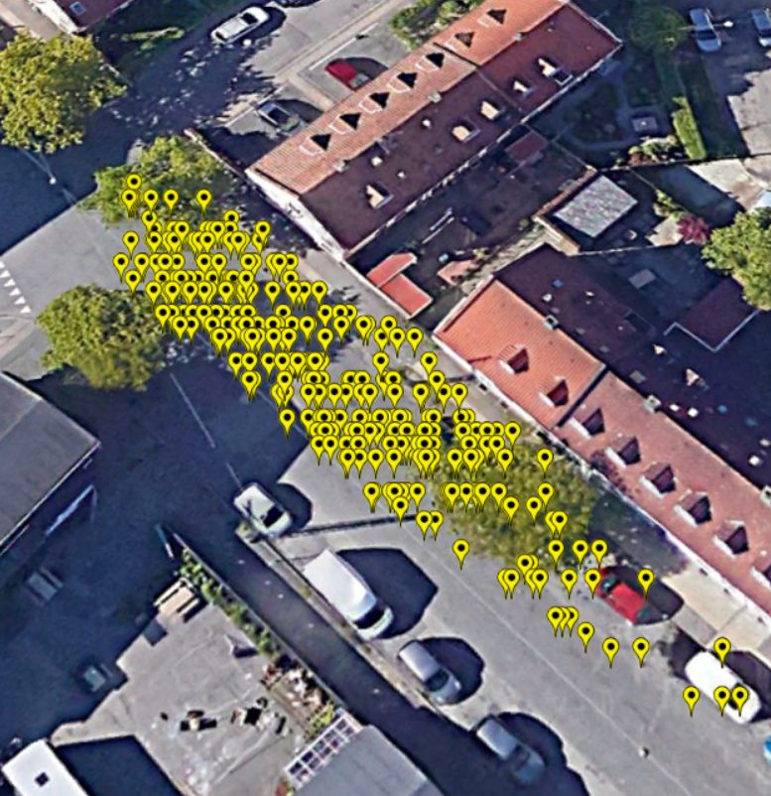
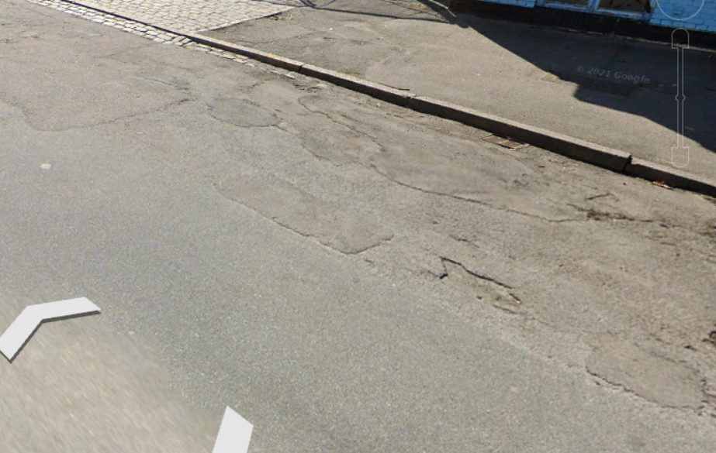
Pothole kml data

Slide 10
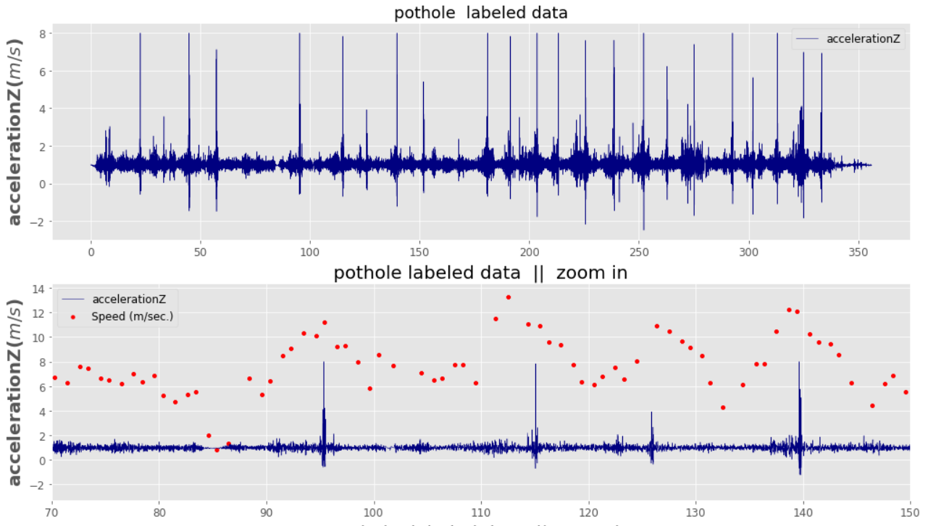
Pothole data plots

Slide 11
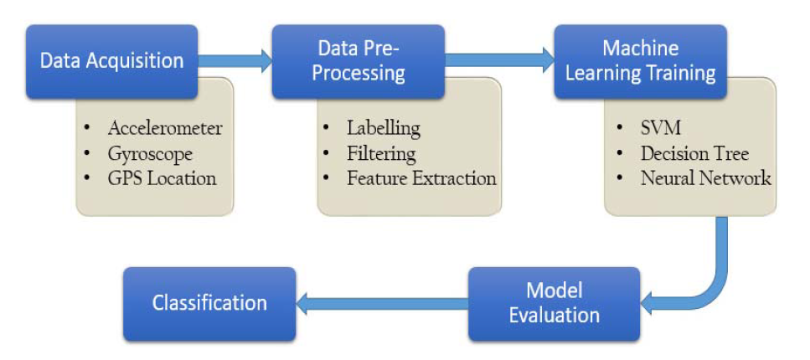
Overall block diagram of the process

Slide 12
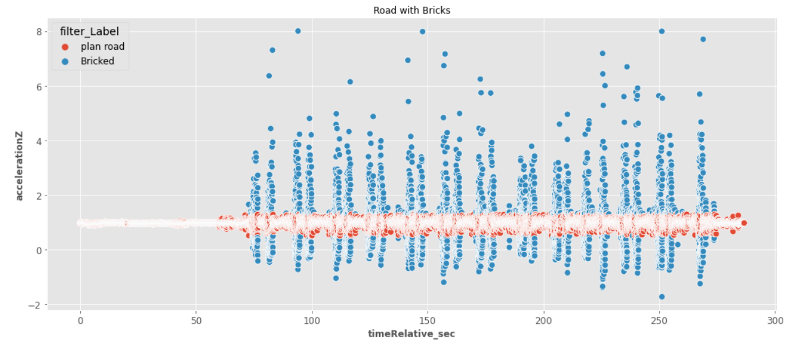
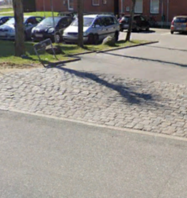
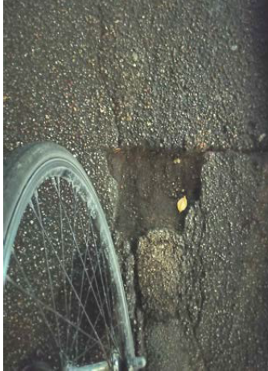
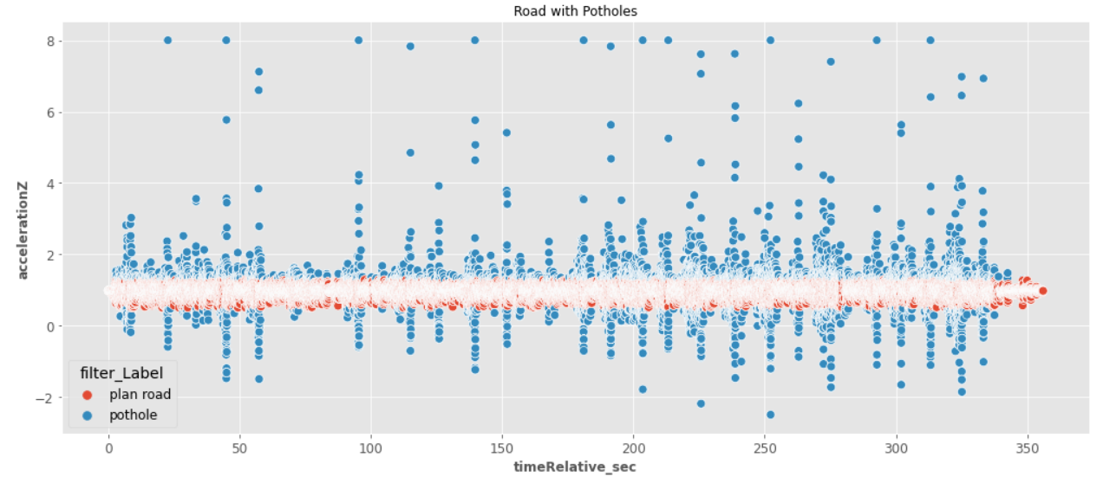
Preprocessing

Slide 13
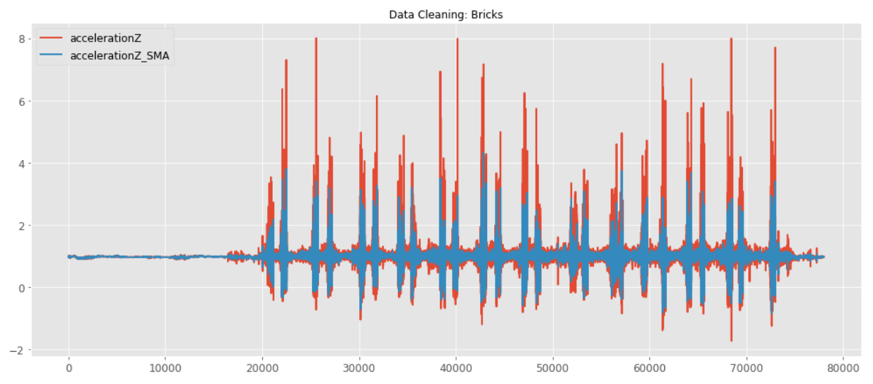
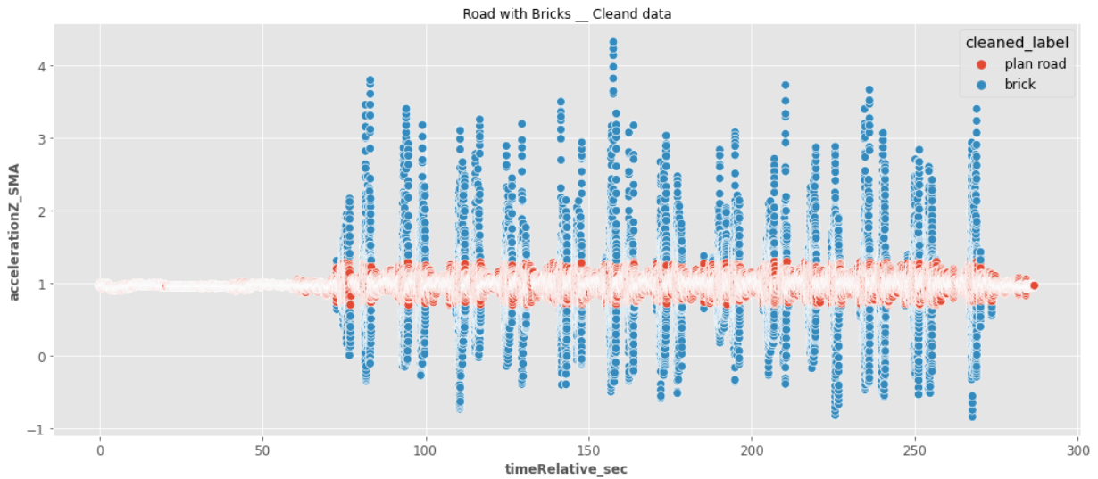
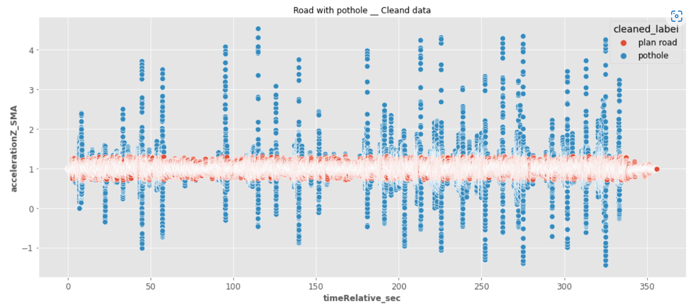
Cleaning with SMA

Slide 14
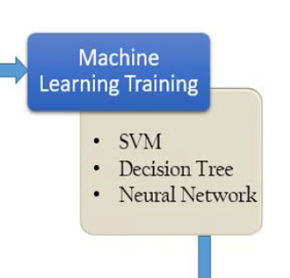
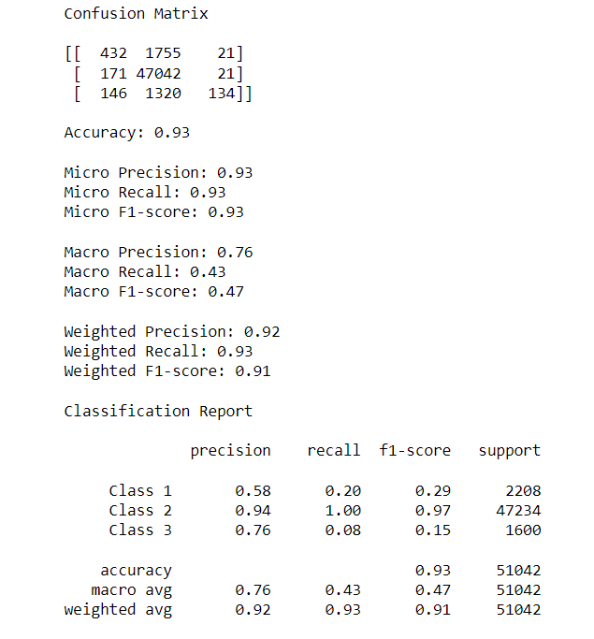
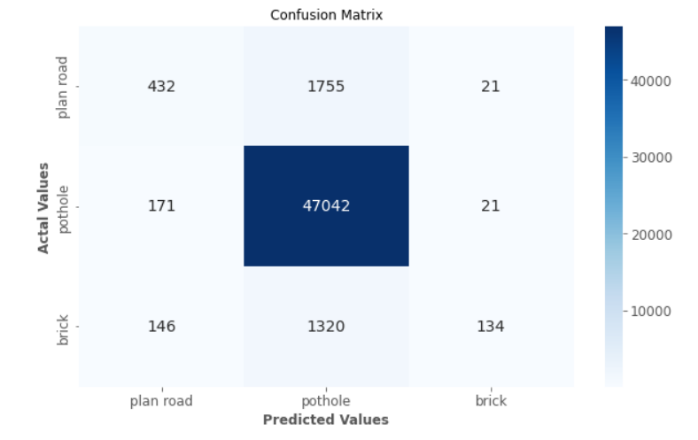
Machine Learning Training.
Model Evaluation

Slide 15

Future work:
Data collection
Data on continuous road.
Constant speed is ideal.
Knowledge about anomaly.
More advance models.
More advance data cleaning techniques. i.e fft and interpolating like scipy.interpolate.splrep().
More advance feature extraction.

